Slide 1
Notes:
DON’T FORGET TO START DATABRICKS CLUSTER!!!!!

Slide 2
Azure
Go to Azure.com
Click ‘Try Azure for free’
You will need:
An email address
A mobile phone
A credit/debit card – don’t worry you won’t be charged!
Choose United Kingdom or US region
$200 credit / 30 days
Some resources are free longer / permanently

Slide 3
VS Code
Free download
Very large number of plug-ins/extensions – most free

Slide 4
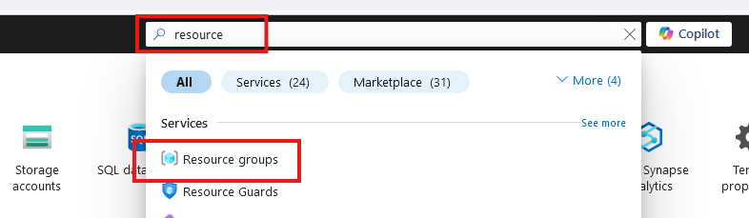
Create Resource Group

Slide 5
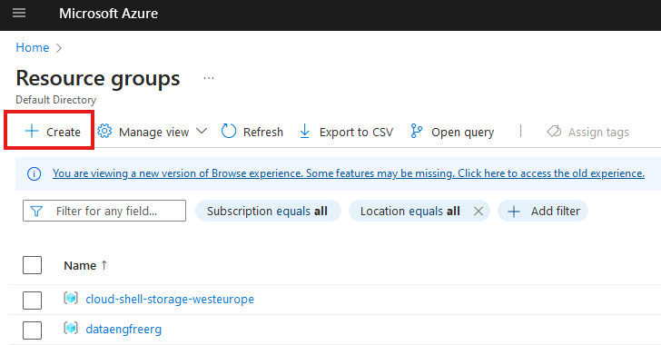
Create Resource Group

Slide 6
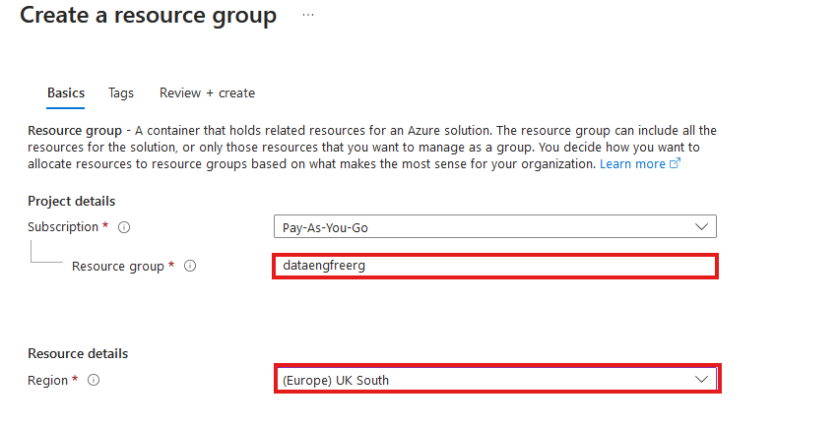
Create Resource Group

Slide 7
Azure CLI
Install by following links from: https://learn.microsoft.com/en-us/cli/azure/install-azure-cli
For VSCode:
Azure CLI Tools
Azure Developer CLI
CLI will require extensions for some commands
Automatically downloaded

Slide 8
Azure CLI Demo

Slide 9
Create storage account
Create in same region as RG
Primary service is ADLS Gen 2
Primary workload Big Data Analytics
Performance: Standard
Redundancy: LRS
Add container > RAW directory

Slide 10
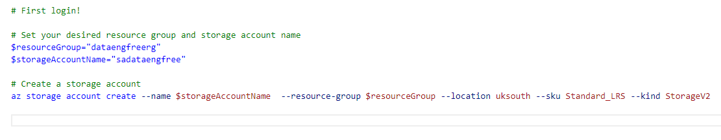
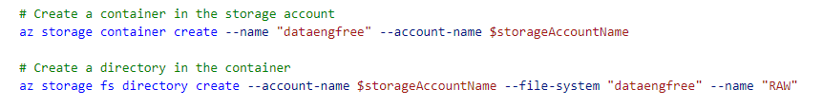
Create storage account

Slide 11
Data & Databases
Concepts to Learn: Data types, databases (SQL and NoSQL), data structures.
Tools/Resources:
Azure SQL Database - free tier available
Cosmos DB: Explore NoSQL databases with a limited free tier on Azure.

Slide 12
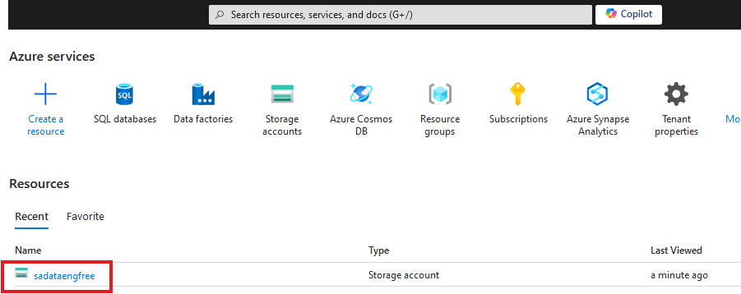

Slide 13
Create Azure Data Factory
Create in same region as RG

Slide 14
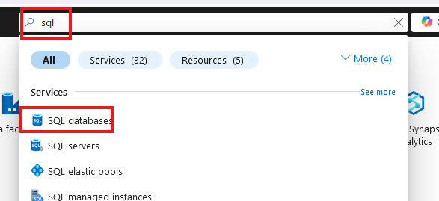
Create SQL database

Slide 15
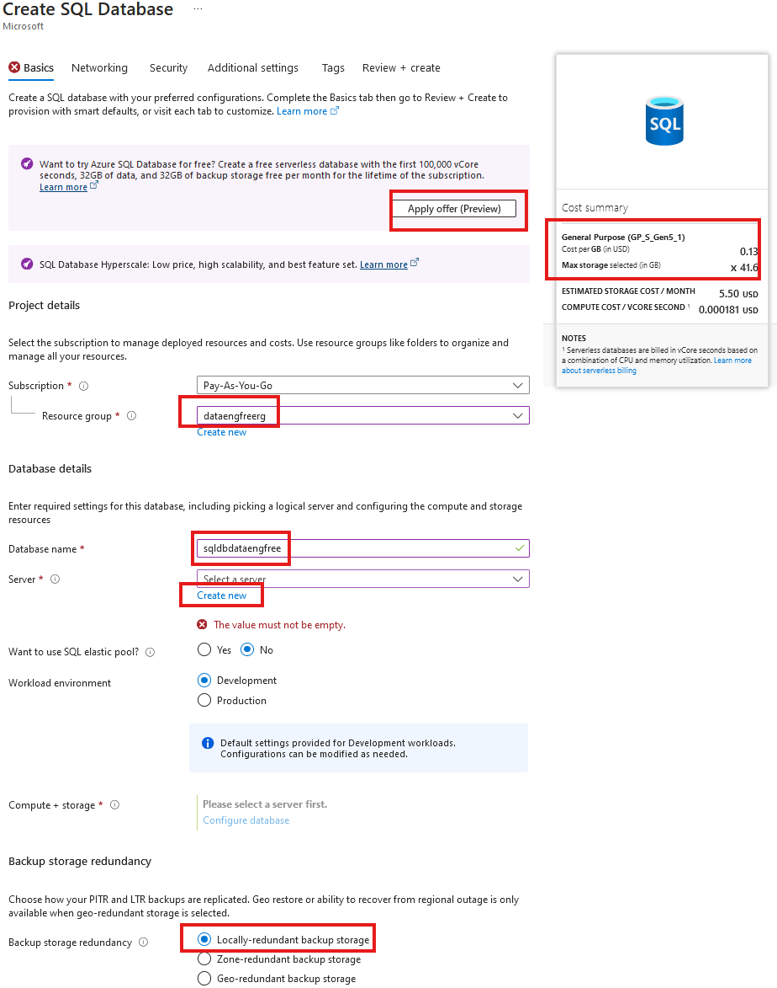
Create SQL database

Slide 16
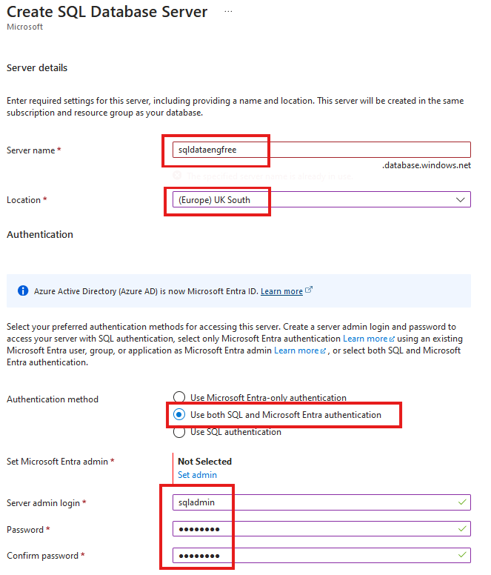
Create SQL database

Slide 17
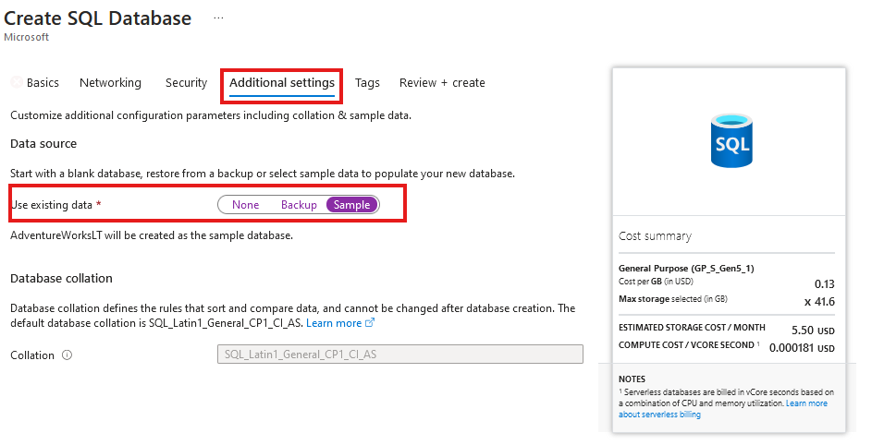
Create SQL database
Add sample data

Slide 18
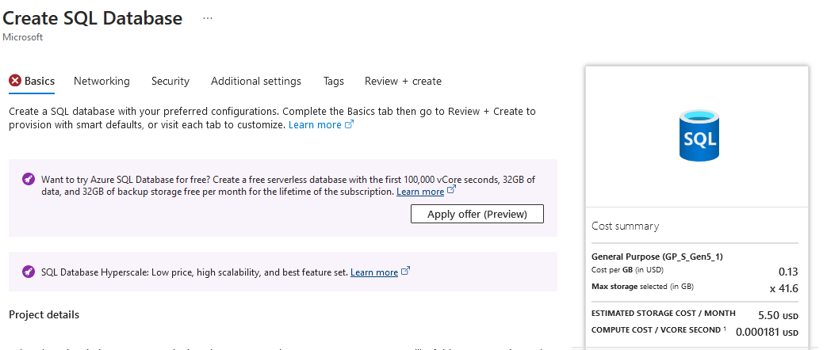

Slide 19
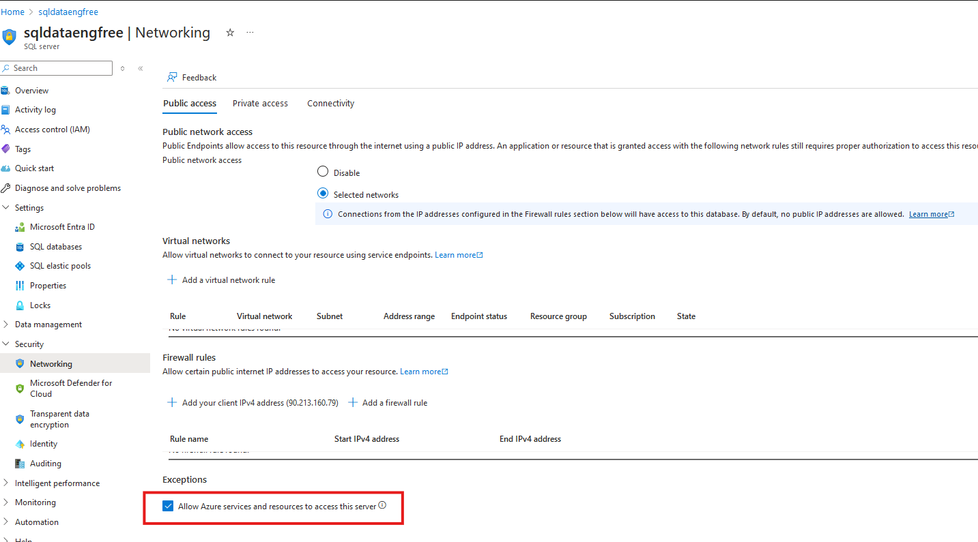

Slide 20
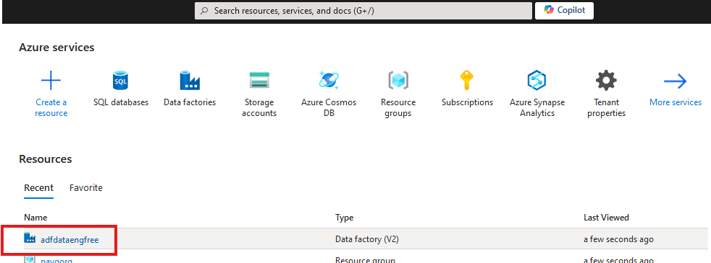


Slide 21
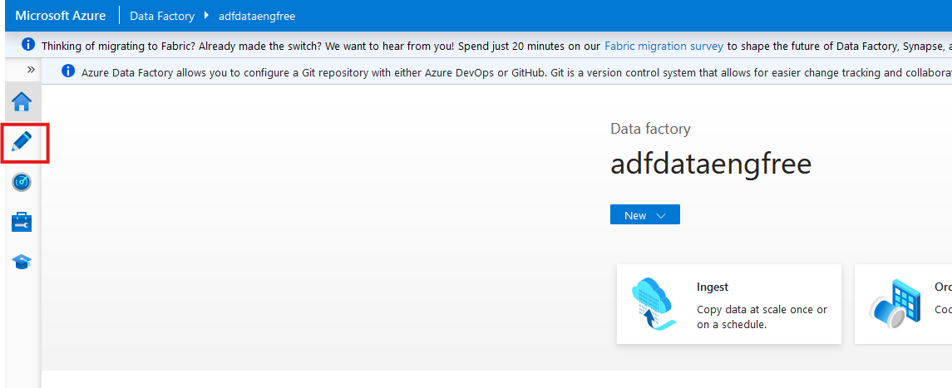

Slide 22
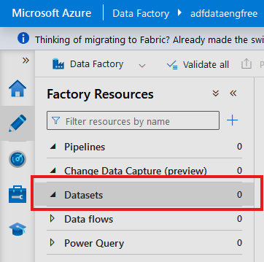
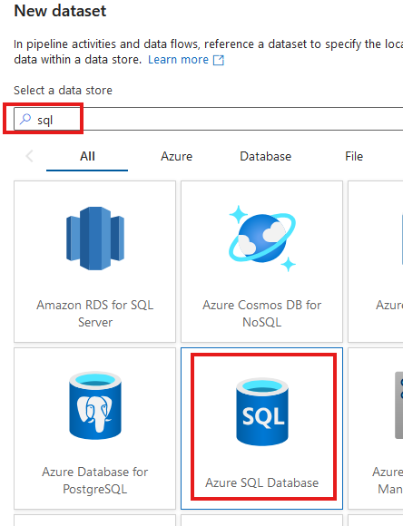

Slide 23
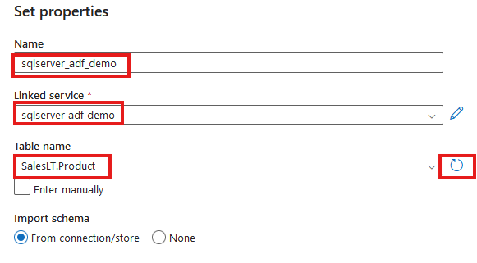

Slide 24
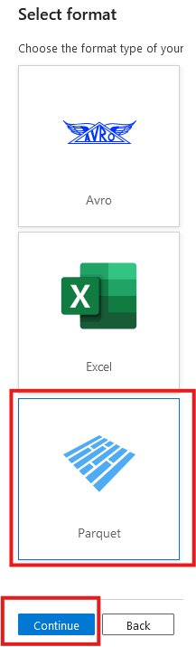
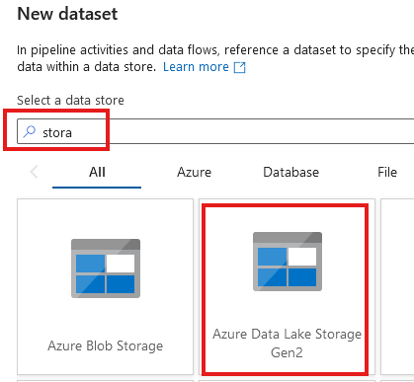

Slide 25
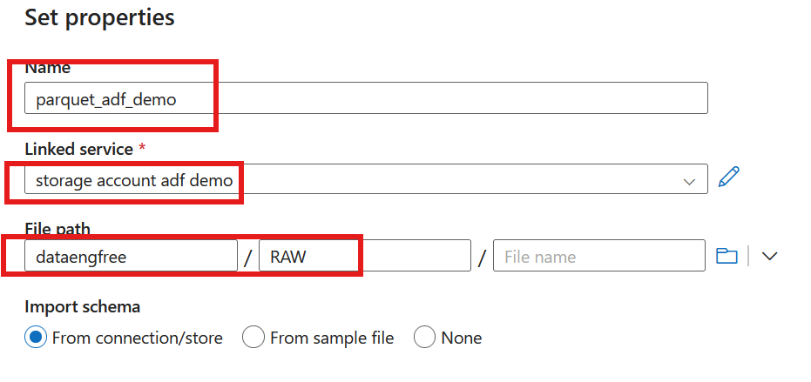

Slide 26
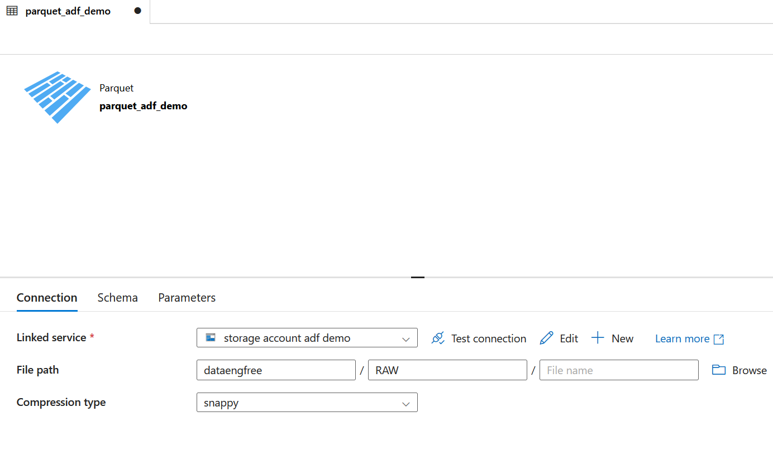

Slide 27
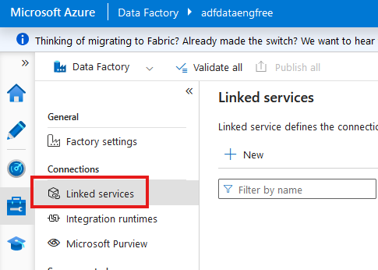

Slide 28
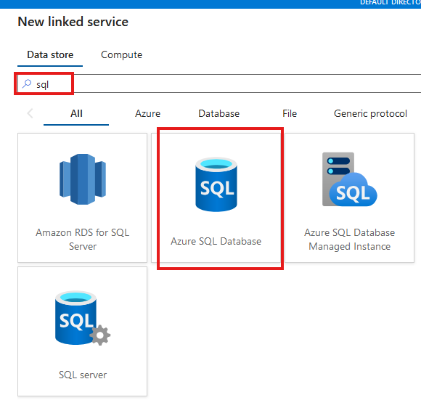

Slide 29
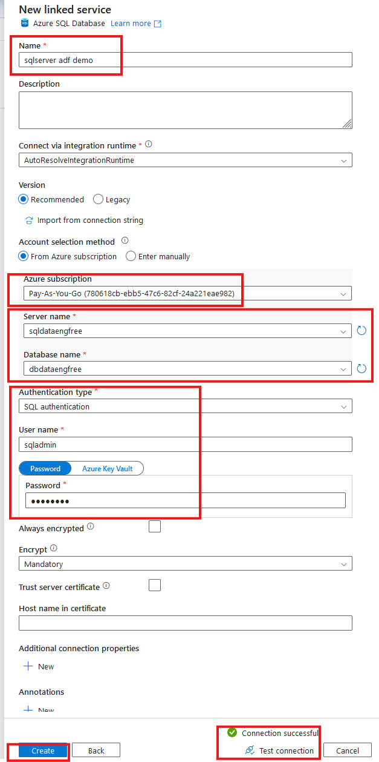

Slide 30
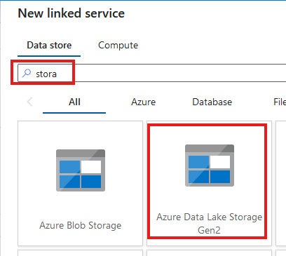
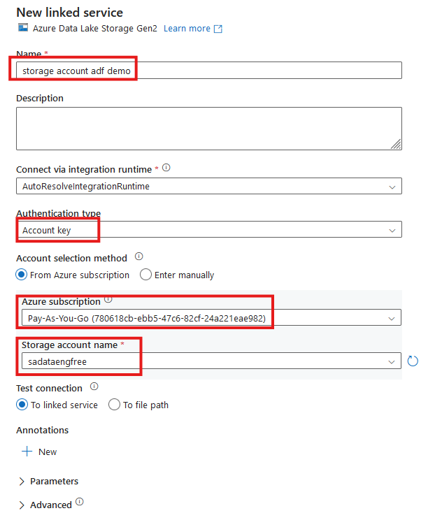


Slide 31
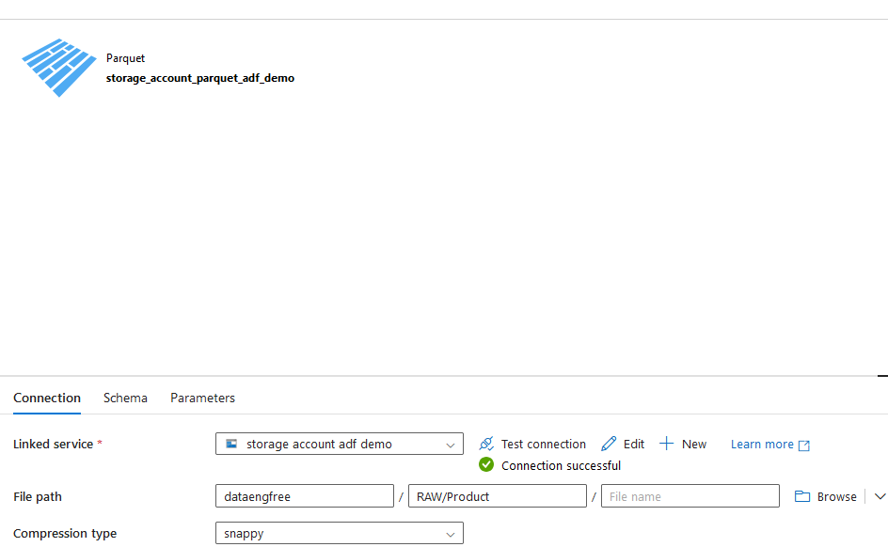

Slide 32
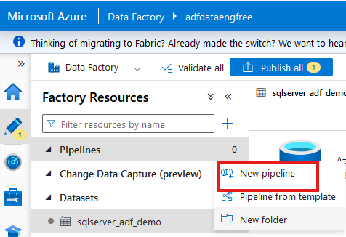
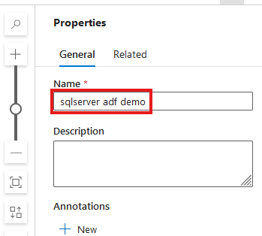

Slide 33
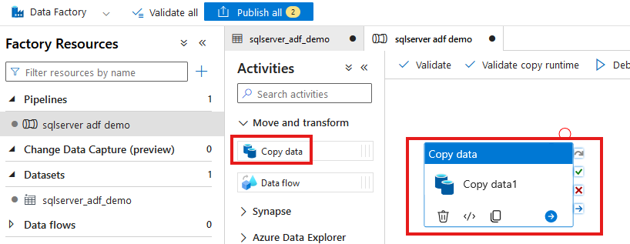

Slide 34
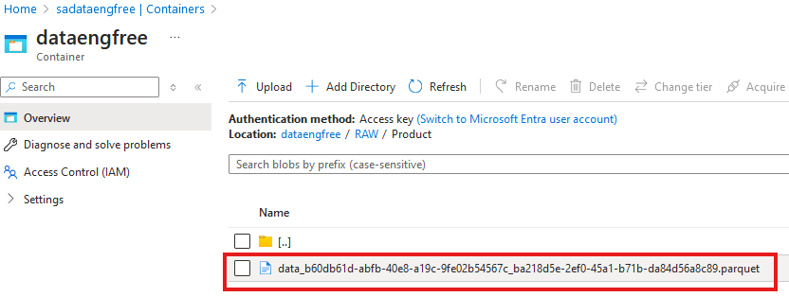

Slide 35
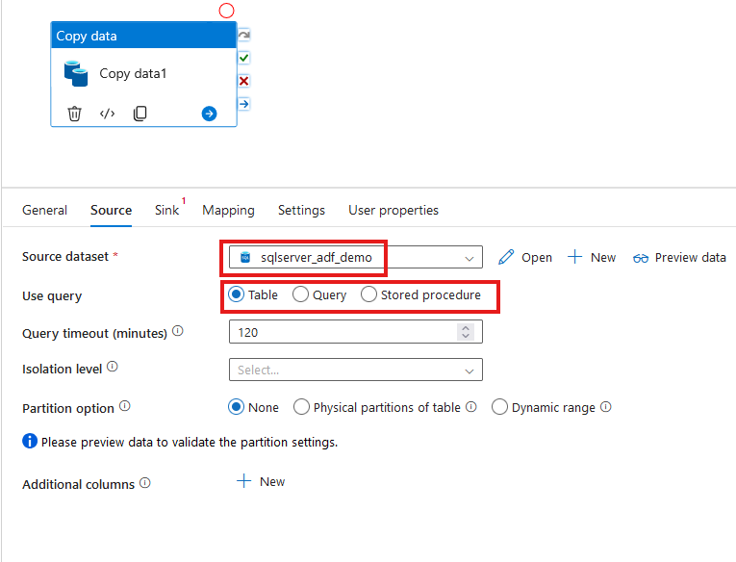

Slide 36
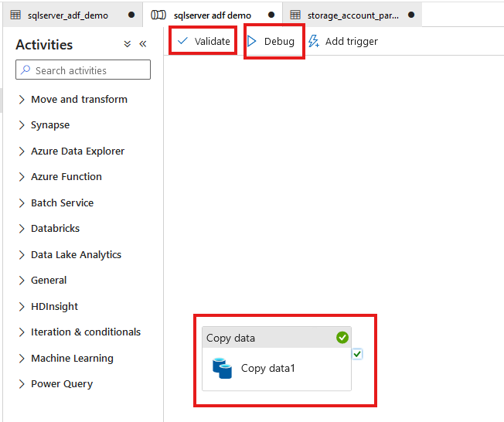

Slide 37
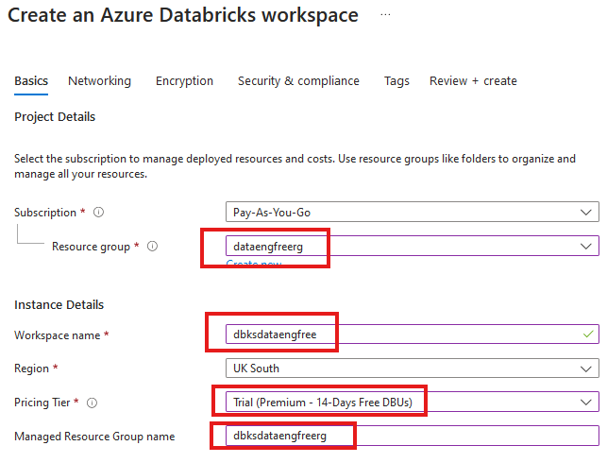


Slide 38
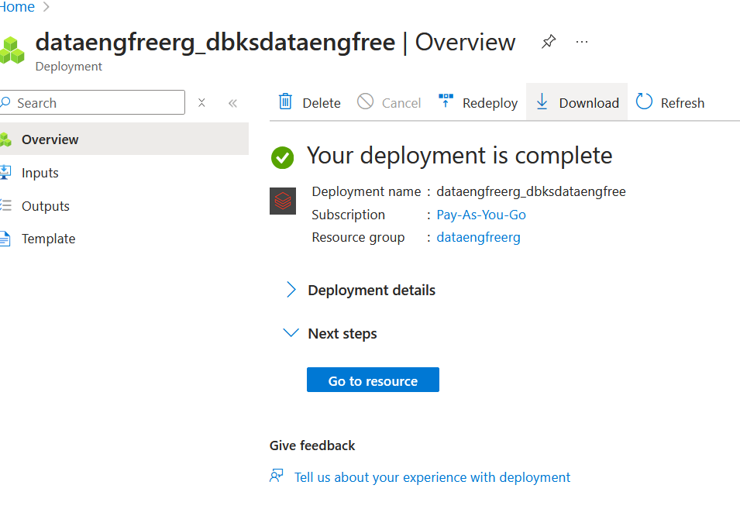

Slide 39
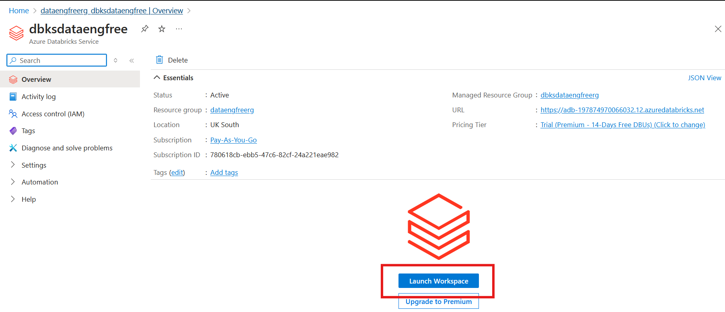

Slide 40
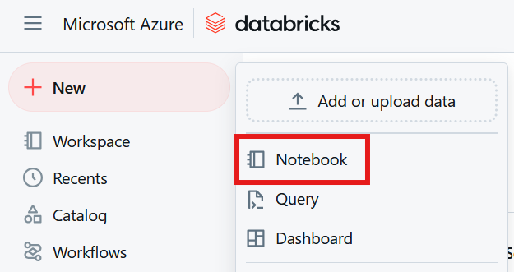

Slide 41
Python
Use Anaconda
Use conda to create environment
Might need to enable Long Paths

Slide 42
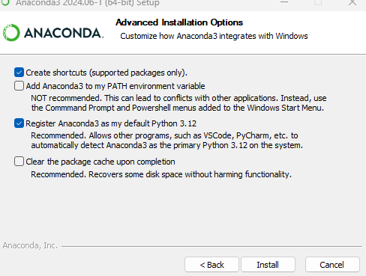
Anaconda install

Slide 43
Conda demo

Slide 44
PySpark Pre-requisites
Install Java (not v 21)
Set paths
JAVA_HOME
PATH
Install Apache Spark
Install winutils.exe
Create virtual environment
Instructions: https://sparkbyexamples.com/pyspark-tutorial/

Slide 45
PySpark Demo
Notes:
PySpark validation
Web UI
VS Code
- to run Jupiter notebooks needs ipykernel installed
- from vscode run conda install -n dataengforfree_env ipykernel
- copy python.exe > python3.exe
Visualisation?

Slide 46
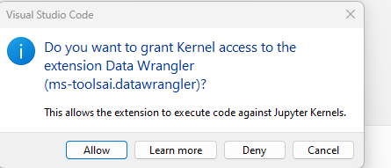

Slide 47
Follow-up Resources
Repo: https://github.com/phil-a10/Talks/tree/main/Data%20Engineering%20Using%20Free%20Tools
Microsoft Learn: https://learn.microsoft.com/en-us/training/career-paths/data-engineer
Kimball books

Slide 48
END

Slide 49
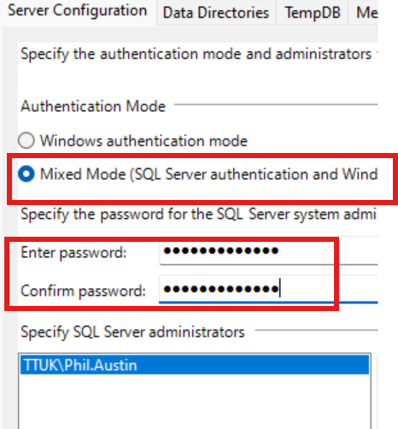

Slide 50
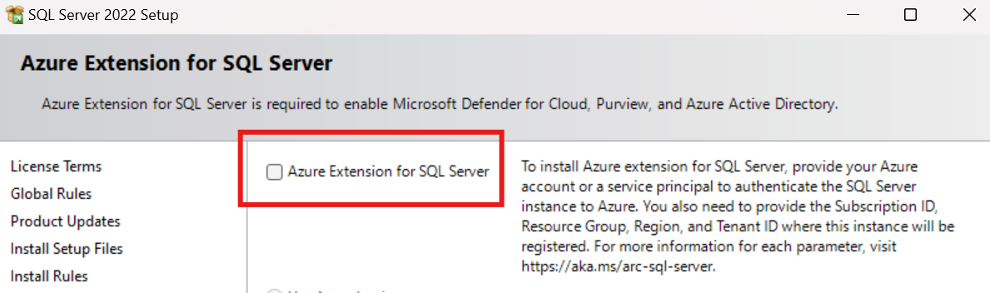
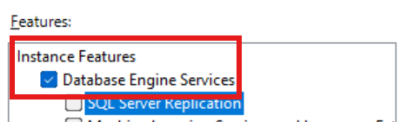
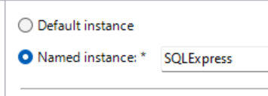

Slide 51
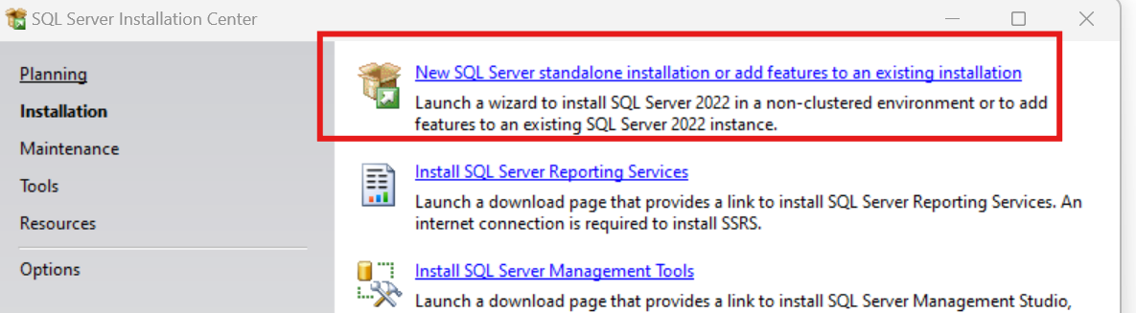
SQL Express!
https://www.microsoft.com/en-us/download/details.aspx?id=104781&lc=1033

Slide 52
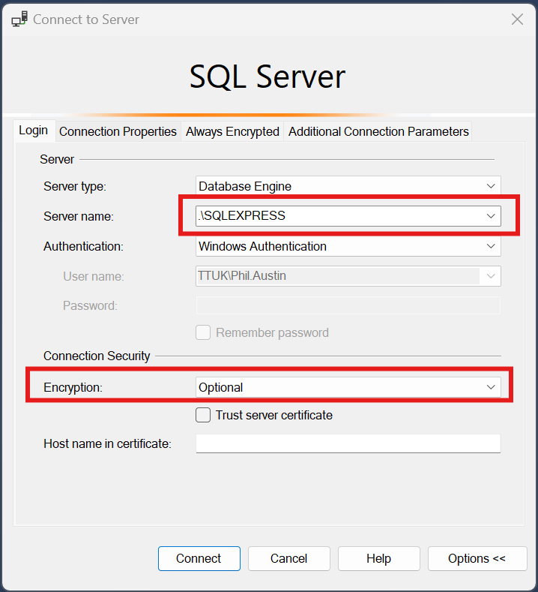

Slide 53
Download JDBC driver: https://repo1.maven.org/maven2/com/microsoft/azure/spark-mssql-connector_2.12/1.2.0/spark-mssql-connector_2.12-1.2.0.jar
Copy jar file to anaconda jars folder

Slide 54
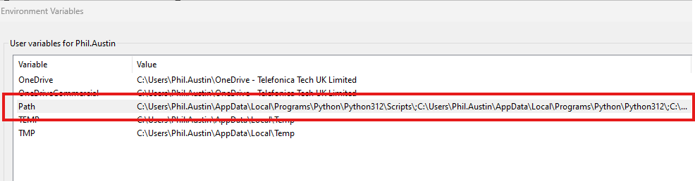
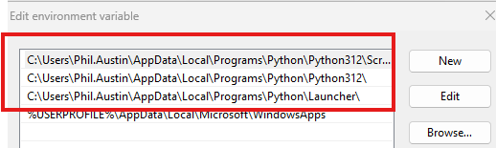
Python pre-reqs

Slide 55
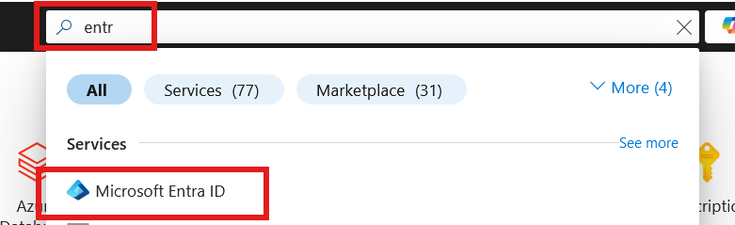
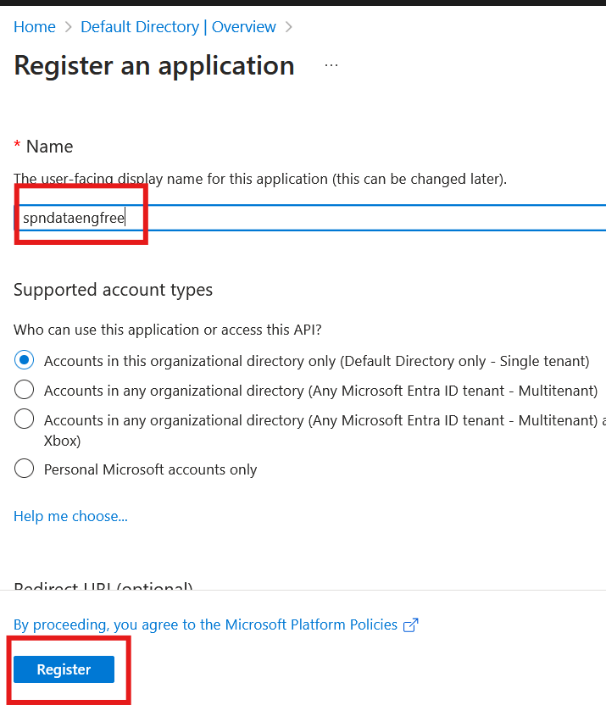

Slide 56
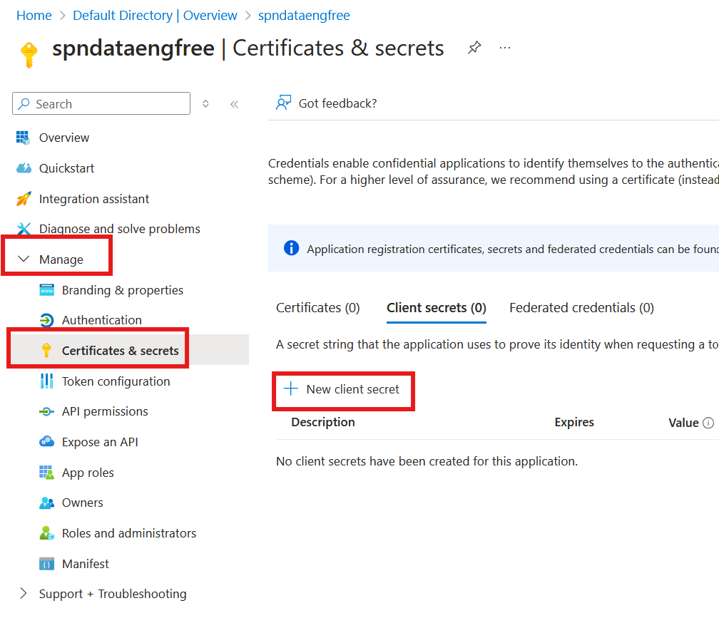


Slide 57



Slide 58


Slide 59

Create storage account

Slide 60

Create storage account

Slide 61

Create storage account

Slide 62



Slide 63


Create Azure Data Factory (ADF)

Slide 64
Create Azure Data Factory (ADF)

Slide 65

Create Azure Data Factory (ADF)

Slide 66


Slide 68
PySpark

